Slide 1
"K-Nearest
neighbors algorithm"
MCS-5803
Kenil Patel
Abhishek Patil
Vansh Savani

Slide 2
WHAT IS THE K-NEAREST NEIGHBORS ALGORITHM?
K-Nearest Neighbors is one of the most basic yet essential classification algorithms in Machine Learning. It belongs to the supervised learning domain and finds intense application in pattern recognition, data mining, and intrusion detection.

Slide 3
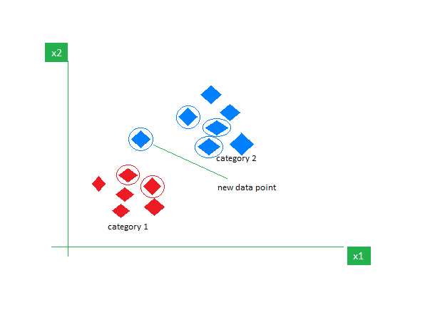
EXAMPLE
If we plot these points on a graph, we may be able to locate some clusters or groups. Now, given an unclassified point, we can assign it to a group by observing what group its nearest neighbors belong to. This means a point close to a cluster of points classified as ‘Red’ has a higher probability of getting classified as ‘Red’.
Intuitively, we can see that the first point (2.5, 7) should be classified as ‘Green’ and the second point (5.5, 4.5) should be classified as ‘Red’.

Slide 4
WHY DO WE NEED A KNN ALGORITHM?
KNN algorithm is a versatile and widely used machine learning algorithm that is primarily used for its simplicity and ease of implementation. It does not require any assumptions about the underlying data distribution. It can also handle both numerical and categorical data, making it a flexible choice for various types of datasets in classification and regression tasks. It is a non-parametric method that makes predictions based on the similarity of data points in a given dataset. K-NN is less sensitive to outliers compared to other algorithms.
The K-NN algorithm works by finding the K nearest neighbors to a given data point based on a distance metric, such as Euclidean distance. The class or value of the data point is then determined by the majority vote or average of the K neighbors. This approach allows the algorithm to adapt to different patterns and make predictions based on the local structure of the data.

Slide 5
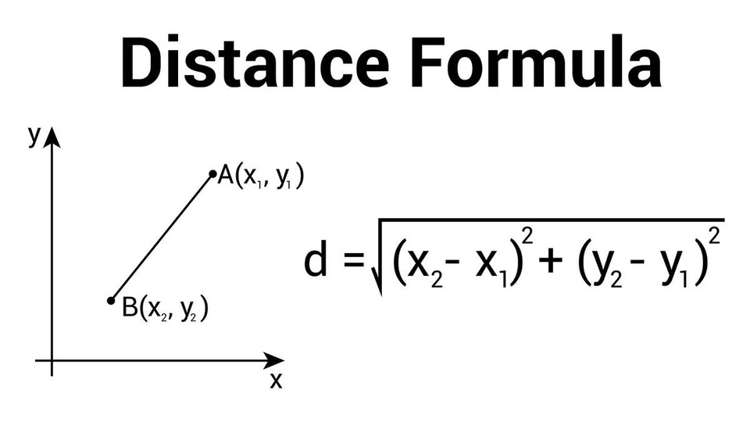
DISTANCE METRICS USED IN KNN ALGORITHM
As we know that the KNN algorithm helps us identify the nearest points or the groups for a query point. But to determine the closest groups or the nearest points for a query point we need some metric. For this purpose, we use below distance metrics:
EUCLIDEAN DISTANCE
This is nothing but the cartesian distance between the two points which are in the plane/hyperplane. Euclidean distance can also be visualized as the length of the straight line that joins the two points which are into consideration. This metric helps us calculate the net displacement done between the two states of an object.

Slide 6
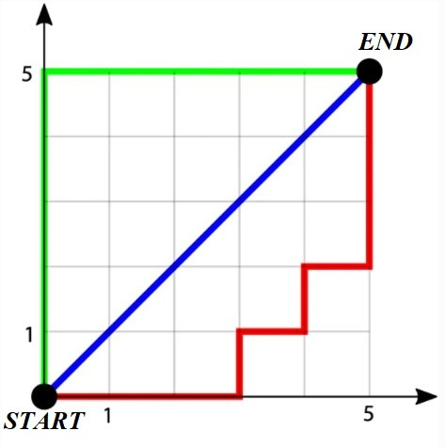
WORKINGS OF KNN ALGORITHM
MANHATTAN DISTANCE
Manhattan Distance metric is generally used when we are interested in the total distance traveled by the object instead of the displacement. This metric is calculated by summing the absolute difference between the coordinates of the points in n-dimensions.
For two points (x1, y1) and (x2, y2), the Manhattan Distance (D) is calculated as follows:
D=∣x2−x1∣+∣y2−y1∣

Slide 7
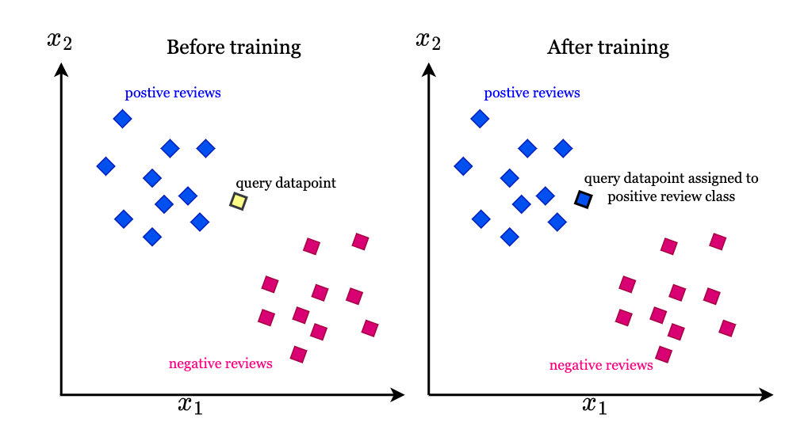
WORKINGS OF KNN ALGORITHM

Slide 8
ADVANTAGES OF THE KNN ALGORITHM
Easy to implement as the complexity of the algorithm is not that high.
Adapts Easily – As per the working of the KNN algorithm it stores all the data in memory storage and hence whenever a new example or data point is added then the algorithm adjusts itself as per that new example and has its contribution to the future predictions as well.
Few Hyperparameters – The only parameters which are required in the training of a KNN algorithm are the value of k and the choice of the distance metric which we would like to choose from our evaluation metric.

Slide 9
DISADVANTAGES OF THE KNN ALGODRITHM
Does not scale – As we have heard about this that the KNN algorithm is also considered a Lazy Algorithm. The main significance of this term is that this takes lots of computing power as well as data storage. This makes this algorithm both time-consuming and resource exhausting.

Slide 10
Time complexity of KNN algorithms
O(nd)
the time complexity is . However, we can reduce the time complexity of KNN algorithms to .
O(log(n))

